Slide 1

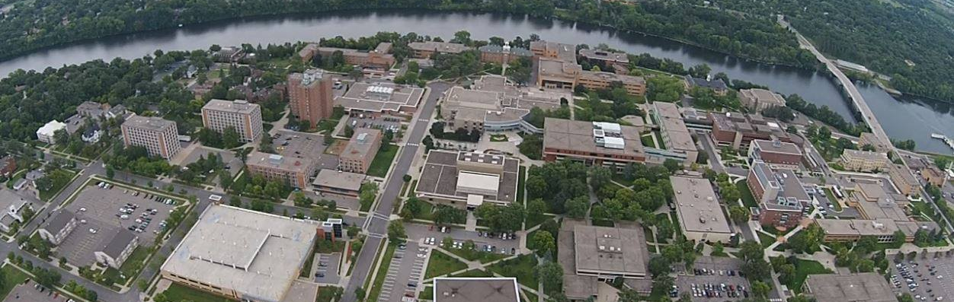
St. Cloud State University
Charting the Future Campus Forum – December, 2015

Slide 2
CTF Campus Forum Members
SCSU President Earl H. Potter
Provost and VP for Academic Affairs Ashish Vaidya
VP for Student Life and Development Wanda Overland
VP for Finance and Administration Tammy McGee
VP for University Advancement Matt Andrew
Director of Human Resources Holly Schoenherr
SCSU Student Government: Summer Vogel, Mikaela Johnson, Randall Olson
AFSCME: Laurie Luethmers, Erin McClure, Hanna Topp-Schefers
Faculty Association: Jo Flanders, Tom Hergert, Kristian Twombley
MAPE: Jen Foley, Craig Overboe, Chris Stanley
MMA: (3 members)
MSUAASF: Tara Winchester, Michelle Schmitz, Mike Penrod

Slide 3
Campus-based CTF
Work Plan Expectations
CTF Initiative | FY2016 CTF Actions/Milestones | Point People | Campus Committee/Council
1.1.2 | Convene campus-based advising work group that researches advising best practices and develops specific recommendations for strengthening advising | Adam Klepetar, University College | Student Success Advisory Council
1.1.2/1.3.1 | Complete college/university Student Success plan | Adam Klepetar, University College | Student Success Advisory Council
 | Complete college/university (diversity) plans | Ellyn Bartges, Equity & Access | Diversity Advisory Council
1.1.6 | Complete evaluation of existing resources and services to meet needs of future and current students | Adam Klepetar, University College Sue Bayerl, Records & Registration | Student Success Advisory Council
1.2.2 | Conduct a campus technology assessment to better understand academic program/ discipline needs, current and future student needs and access, and institutional capacity to meet needs of current and future students and faculty | Henry May, Information Tech Services | Technology Advisory Council
3.1.1 | Establish stretch goals and prepare for the statewide scholarship campaign to raise $50M over two years | Matt Andrew, University Advancement
3.1.1 | Continue to deploy financial literacy programs for students as well as family financial planning | Adam Klepetar, University College Mike Uran, Financial Aid Mike Sharp, Advising | Student Success Advisory Council
 | Monitor SCSU engagement in broader CTF system-wide efforts | Ashish Vaidya, Provost | CTF Campus Forum

Slide 4
CTF Campus Forum Dates
CTF Forum 1: November 4, 2015: 12:30-1:30 p.m., Atwood Glacier Room
CTF Forum 2: December 15, 2015: 8-9 a.m., Atwood Glacier Room
CTF Forum 3: February 2, 2016: 3-4 p.m., Atwood Glacier Room
CTF Forum 4: March 30, 2016: 1-2 p.m., Atwood Glacier Room
CTF Forum 5: May 3, 2016: 3:30-4:30 p.m., Atwood Alumni Room

Slide 5
Next Steps
CTF website?
Initiative updates and timelines
System Level Updates

Slide 6


